Slide 1
ESC201T : Introduction to Electronics
HW8: Solution
B. Mazhari
Dept. of EE, IIT Kanpur

Slide 2
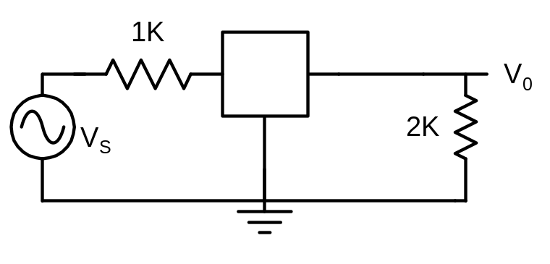
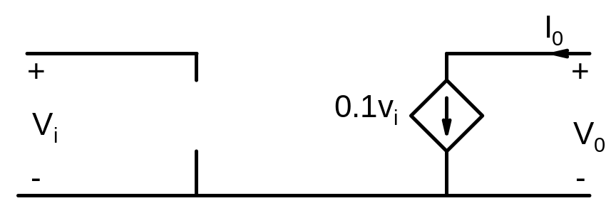
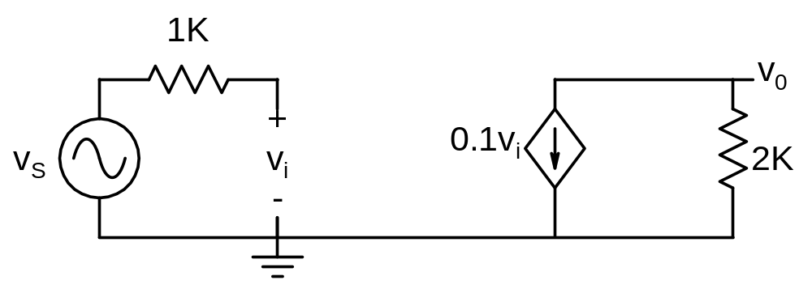


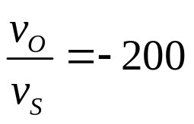
Q.1 Determine the voltage gain of the amplifier for the ideal transistor model shown below

Slide 3
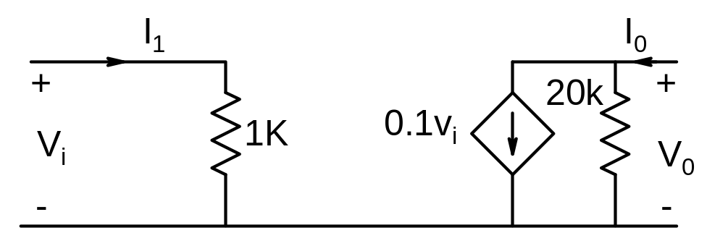
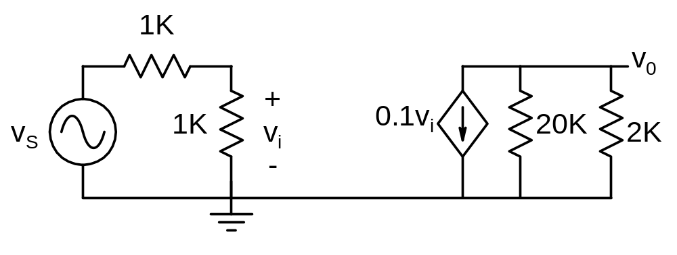


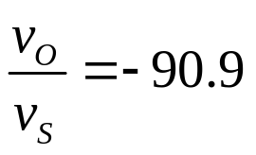
Q.2 Determine the voltage and power gain of the amplifier shown below on the left for the transistor model shown below on the right
Note that the consequence of finite input and output resistance is to reduce gain.

Slide 4
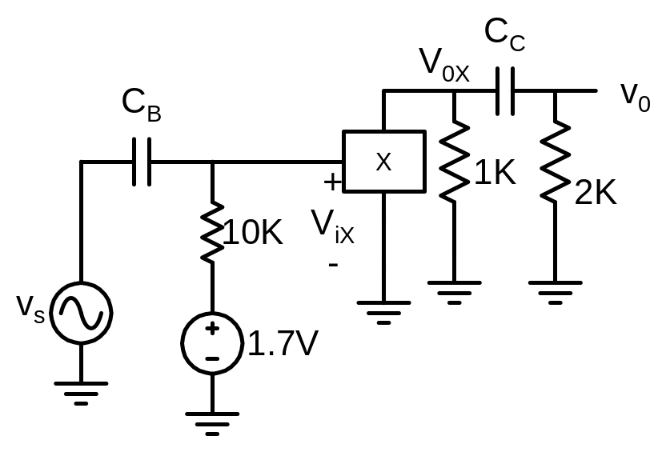
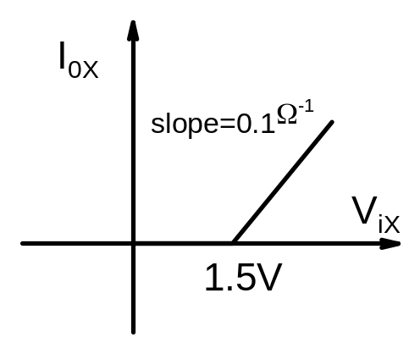
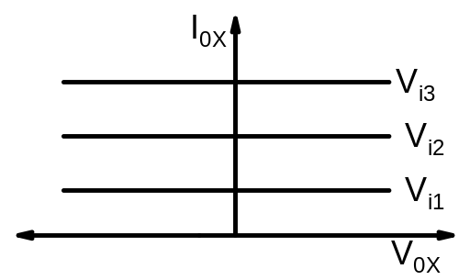
Q.3 Carry out dc and ac analysis of the amplifier circuit shown below on the right for the device X characteristics shown below on the left. Sketch V_{ix} V_{ox} and v_{o} for v_{s} = 0.2Sin(ωt).
When there is both dc and ac source in the circuit, voltages and currents in general will have a dc component and an ac component. As a result two analysis, one dc and another ac have to be carried out.
Note the convention in naming voltage (or current) at node X
All capital letters
All small letters
Subscript is small letters

Slide 5
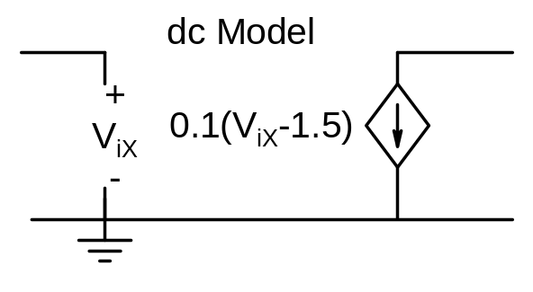
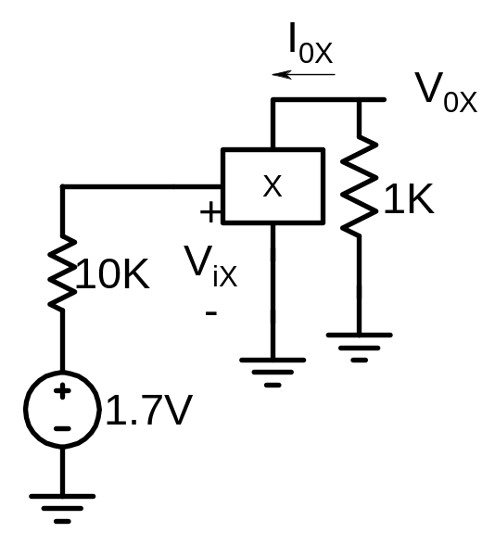
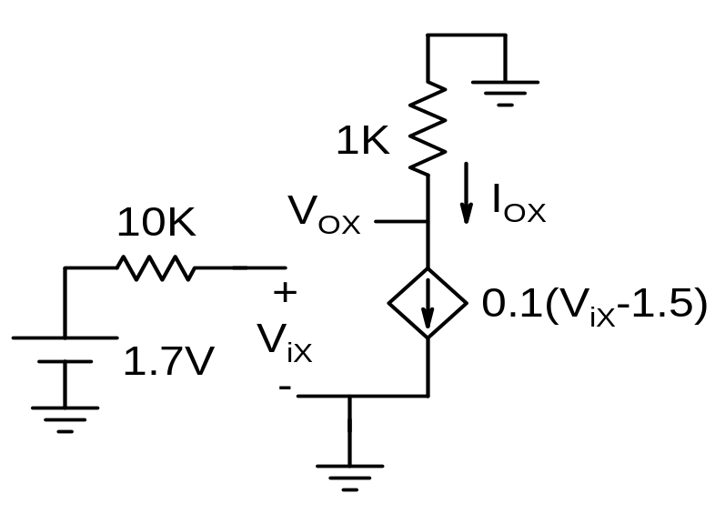
Dc analysis: draw the dc circuit obtained by open circuiting the capacitors

Slide 6



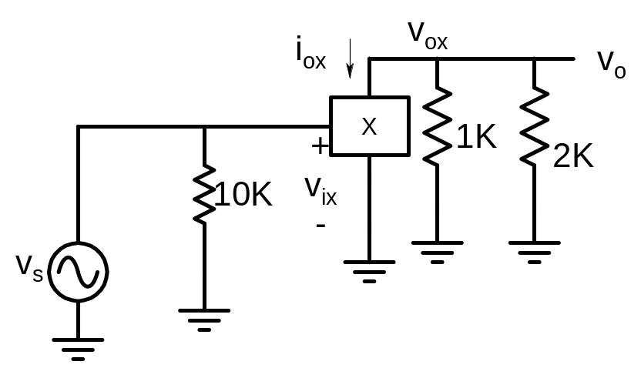
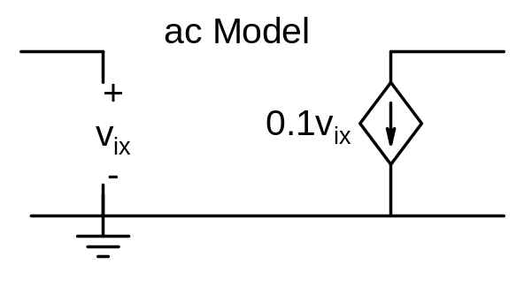
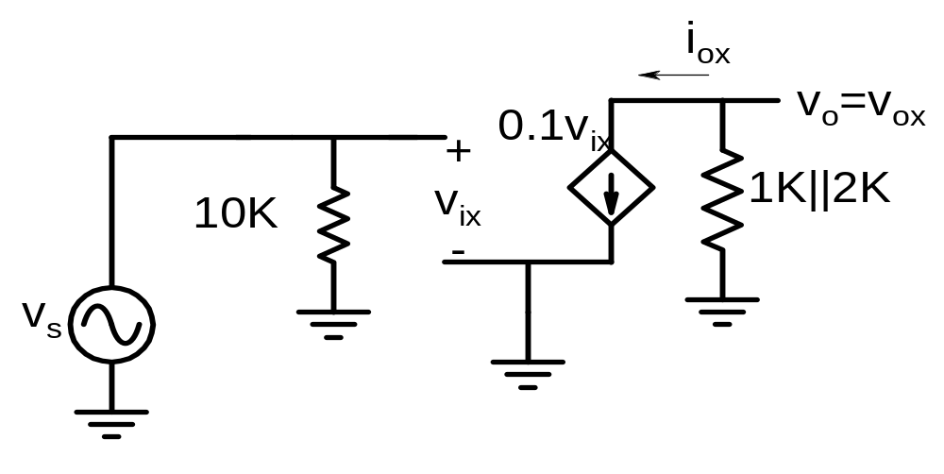
Ac Analysis: draw the ac circuit by shorting the dc sources and capacitors

Slide 7








Slide 8
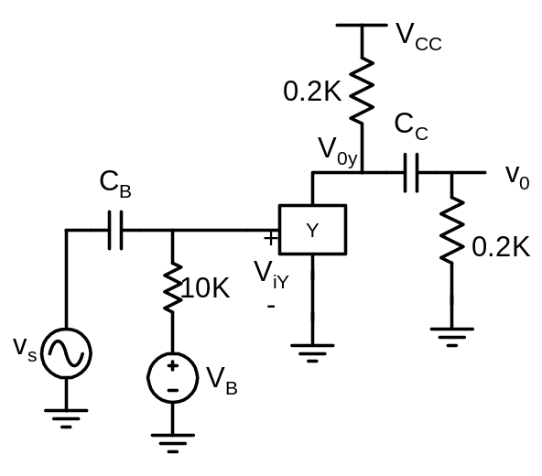
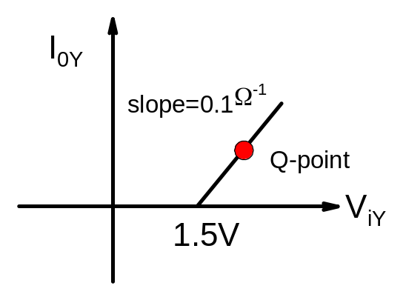
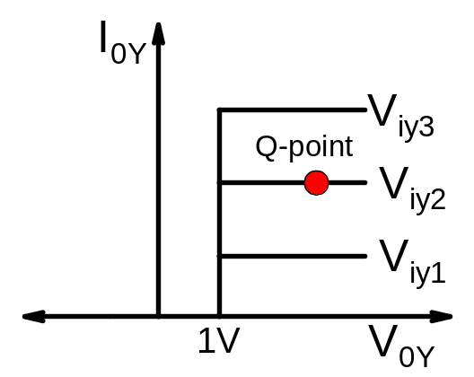


Q.4 Determine appropriate Q point (dc value of V_{iY} and V_{OY}) so that the amplifier shown below on the right would properly amplify an input voltage of v_{s} = 0.2Sin(ωt). Determine minimum supply voltage V_{CC} for which the amplifier would work properly.
To ensure proper operation of the amplifier we have to make sure that device Y always operates in the region V_{iy} > 1.5V and V_{oy} > 1V
We need to carry out dc and ac analysis to find dc and ac components of voltages

Slide 9
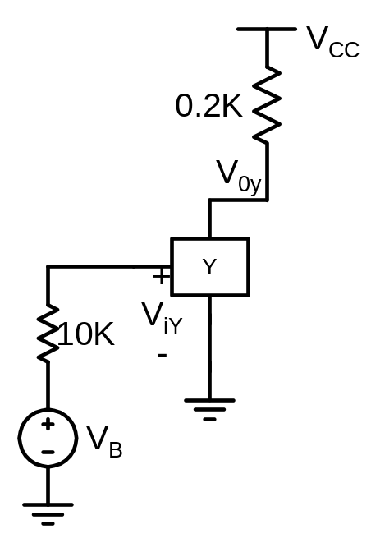

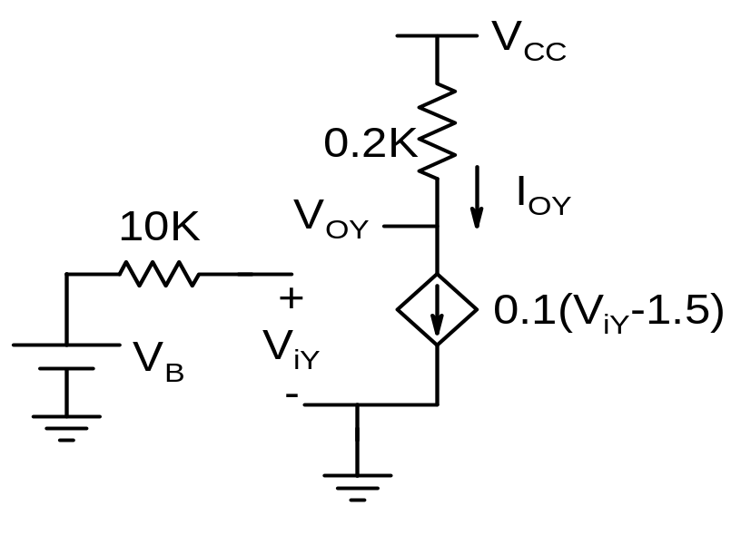



Dc analysis

Slide 10
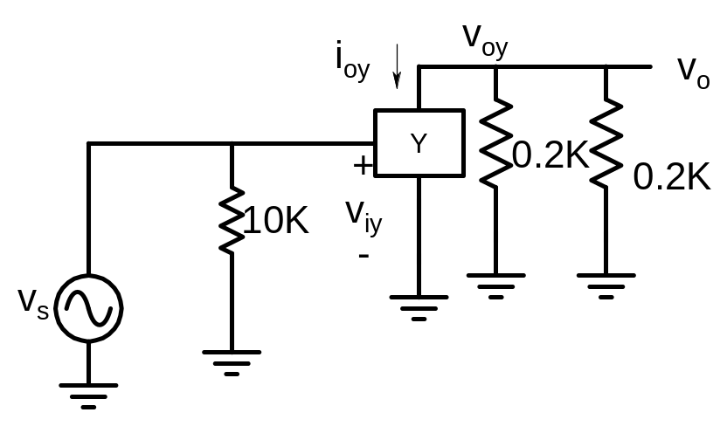

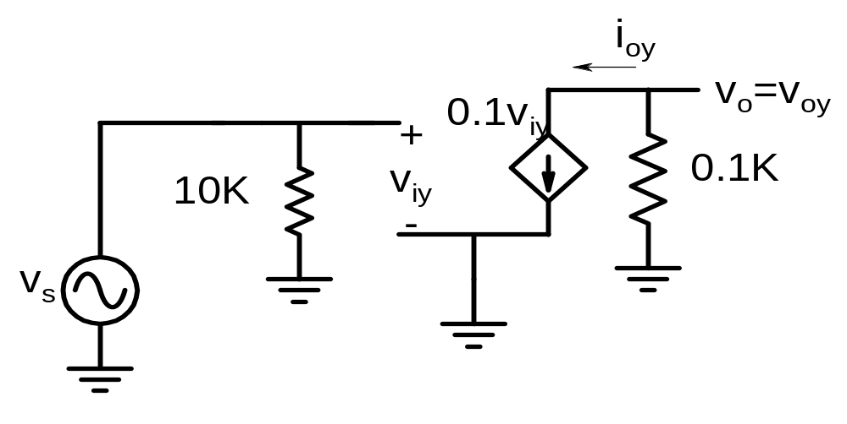



Ac analysis

Slide 11




Proper Q-point for Amplification
Let us choose V_{IY} = 1.8 and V_{OY} = 4

Slide 12
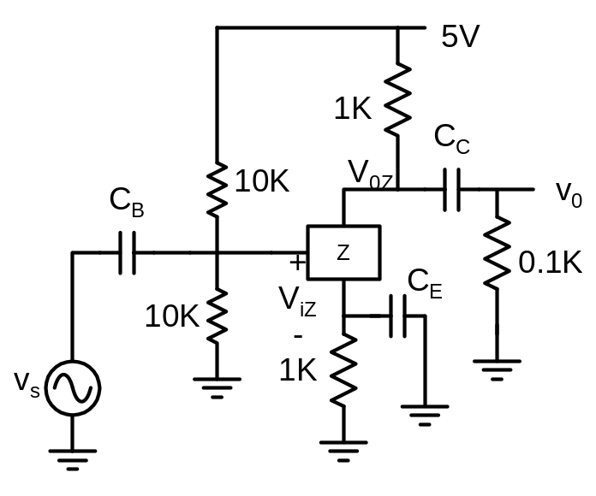
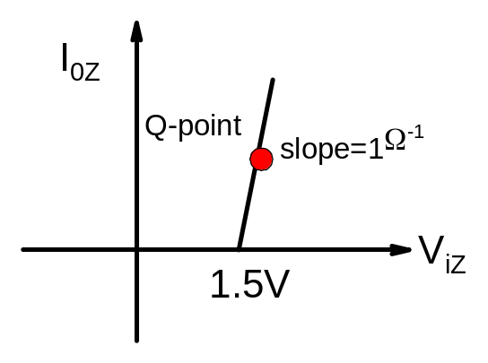

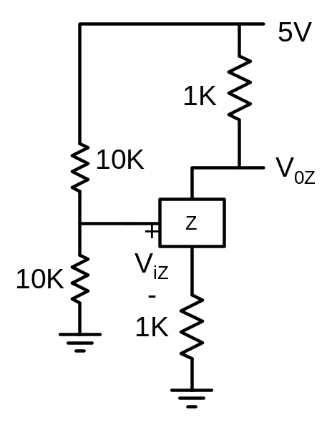
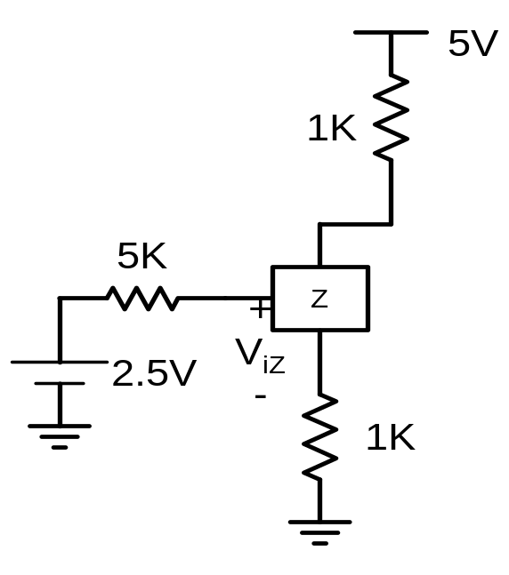
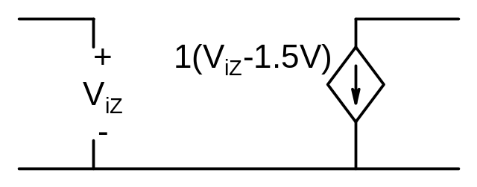
Q.5 Carry out dc and ac analysis of the amplifier circuit shown below on the right to determine bias or Q- point (dc value of I_{OZ} and V_{OZ}) and ac voltage gain.
Dc analysis: draw the dc circuit obtained by open circuiting the capacitors
Thevenin’s Th.

Slide 13
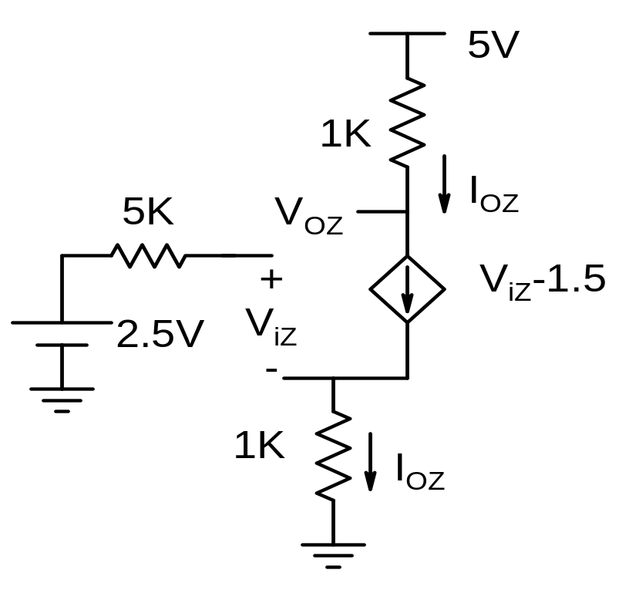



Since I_{oZ} vs. V_{iZ} characteristics is very sharp, V_{iZ} ~ 1.5V

Slide 14
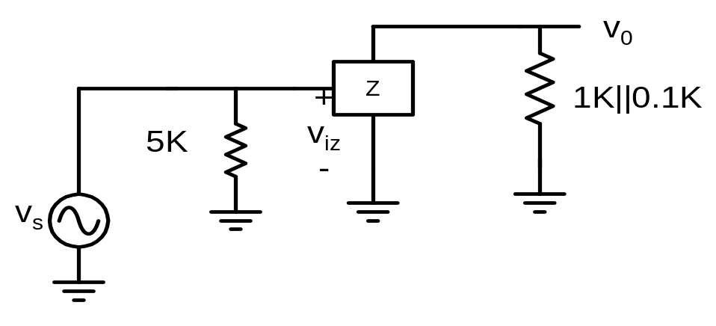
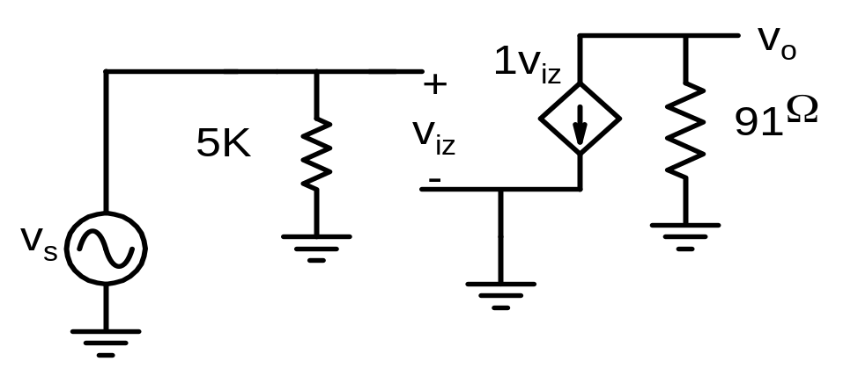
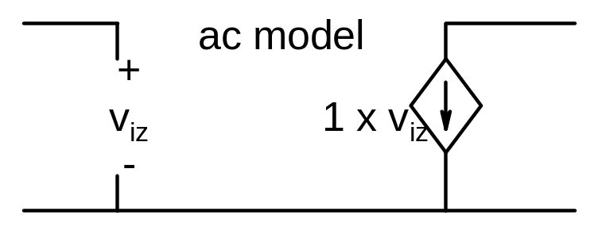
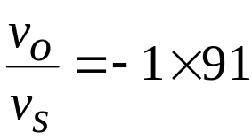
Ac Analysis: draw the ac circuit by shorting the dc sources and capacitors

